Slide 1
How do Gamers Feel?
Joshua Sonnen
sonnenj@wwu.edu

Slide 2
Original Data
TextBlob Generated
Game Sales
900,000 reviews across 242 games. Gathered from a web scrape of Steam. Posted on Kaggle.
Review Features
review message
hours_played
funny and helpful votes
recommendation (binary)
Date
Game Features
Game_name (290)
Publisher (173)
Developer (216)
Genres (list[str])
overall_player_rating (11)
Number of review from purchased people
Number of english reviews
I threw the data through TextBlob which generated some useful attributes for each review.
Review Features
Number of words
Number of sentences
Polarity (3)
Objectivity/Subjectivity (2)
–“How opinionated the review is”
Gathered from a web scrape of Steam DB. Posted on Kaggle.
Game Features
NA sales
EU sales
JP sales
Other sales
Global sales
Sales are in millions of copies.
Notes:
Interesting Tasks
Subsets of my data: “high voted reviews”, “high hours_played”,
Game_name, developer, publisher are all variables to predict (from hours_played, funny/helpful votes, textblob data)
Predict recommendation from TextBlob generated data
How to use genre?
Multi-hot vector
Sklearn discretization of hours_played (for better accuracy)
Histograms
Recommend vs polarity and objectivity
Hours_played vs polarity and objectivity and length of review
Date vs frequency. (discover when this data was created)
2 graphs. 1 for recommend; 1 for not recommend

Slide 3

Is TextBlob an accurate tool?
Polarity Objectivity Message
['positive', 'subjective', 'I feel so happy today.']
['neutral', 'objective', 'The sky is blue.']
['neutral', 'objective', "I'm worried about the future."]
['positive', 'subjective', 'She seems very kind.']
['neutral', 'objective', "I don't know what to do."]
['neutral', 'objective', 'The meeting starts at 3 PM.']
['negative', 'subjective', 'That movie was terrible!']
['positive', 'objective', 'I love spending time with my family.']
['neutral', 'objective', 'It rained for two hours yesterday.']
['neutral', 'objective', "I'm feeling really stressed right now."]

Slide 4
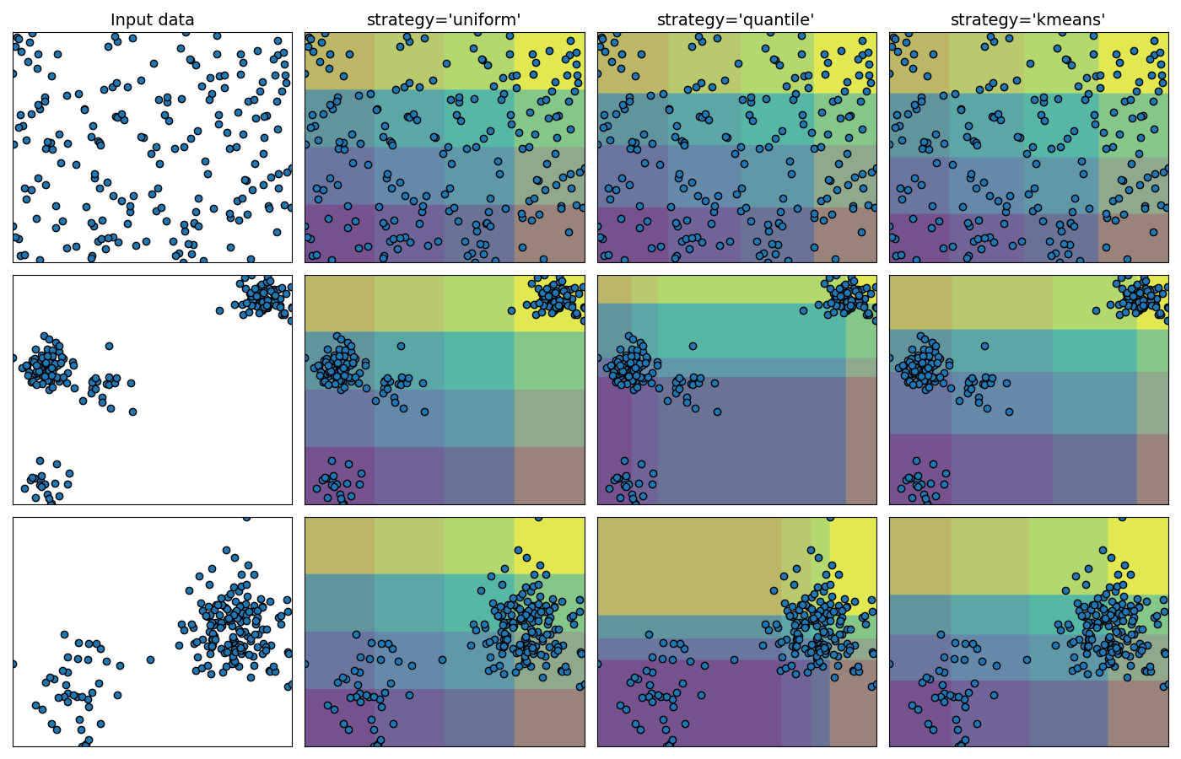
Hours Played Discretization
Split by equal frequency
Split by equal ranges
Remove outlier: Hours_played < 1,000
K Means Classify hours played
log(hours_played) then discretize by equal ranges
Source: sklearn “Demonstrating the different strategies of KBinsDiscretizer”

Slide 5
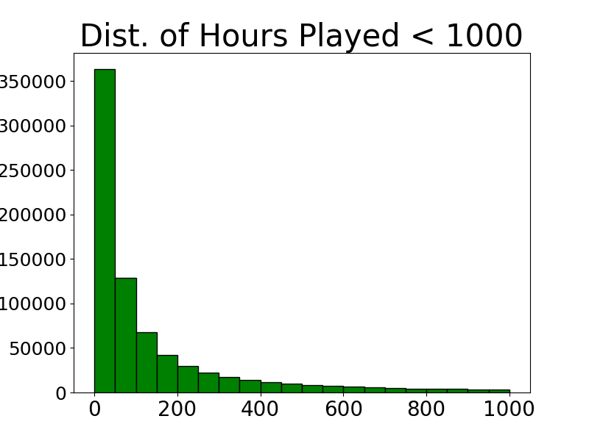
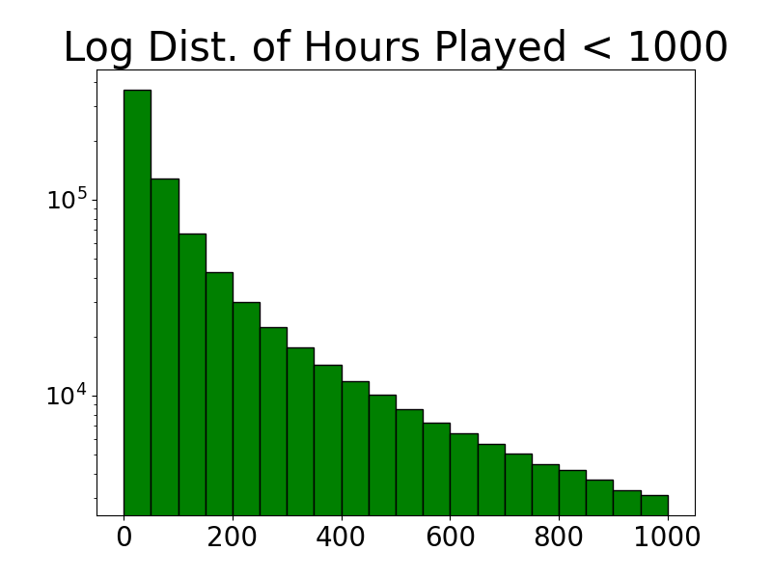
Throughout all analysis and classification, I use the subset of data where hours_played < 1000. This data nicely follows a logarithmic distribution.

Slide 6
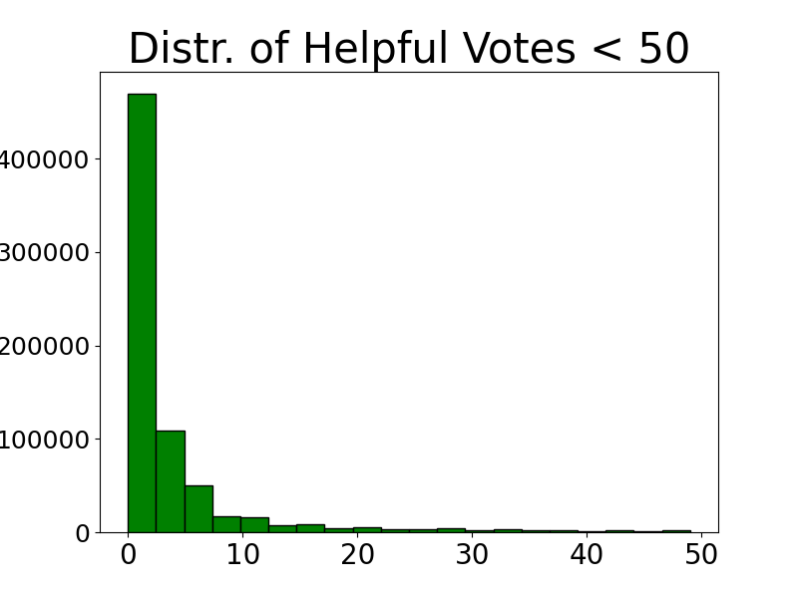
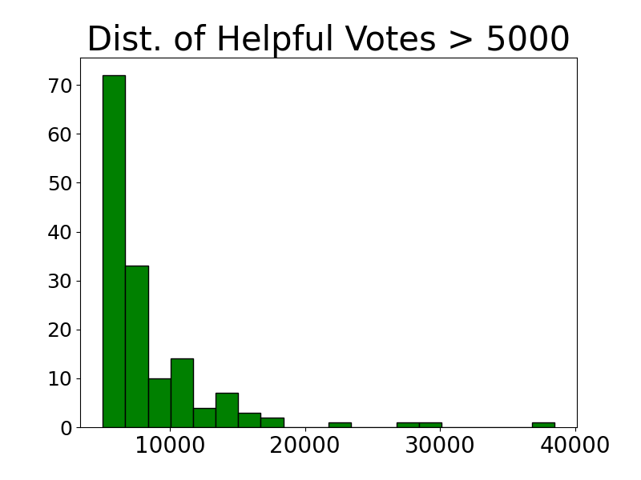
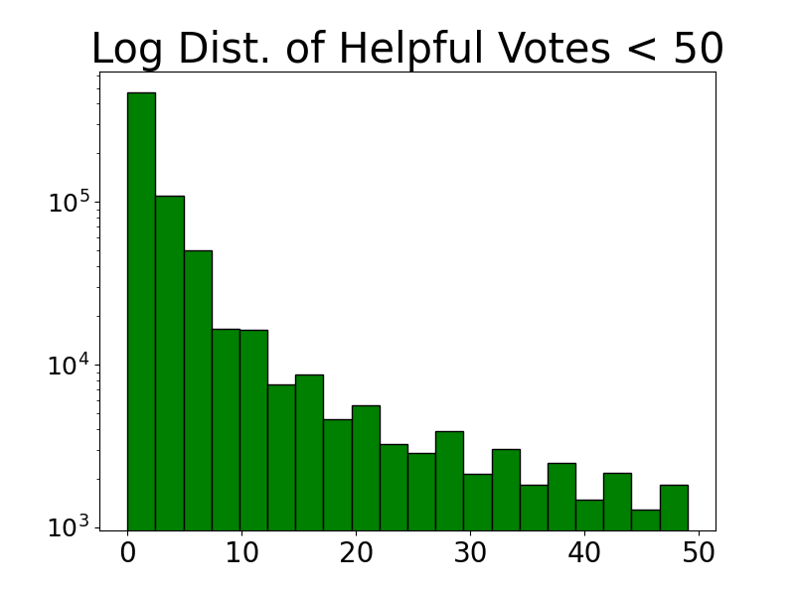
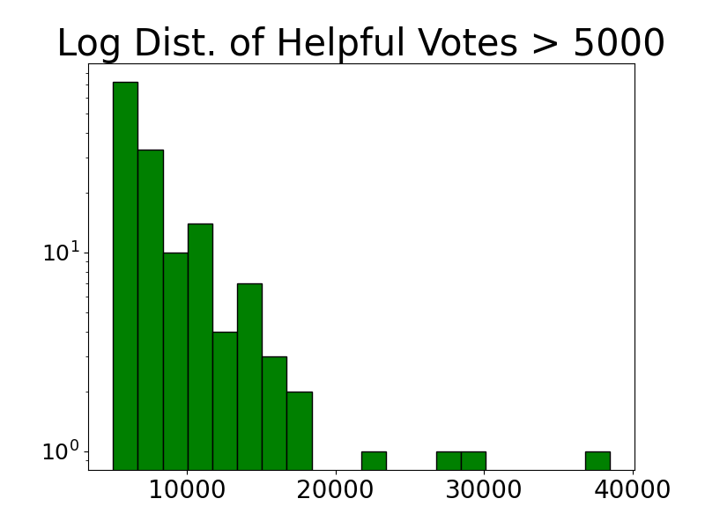

Slide 7
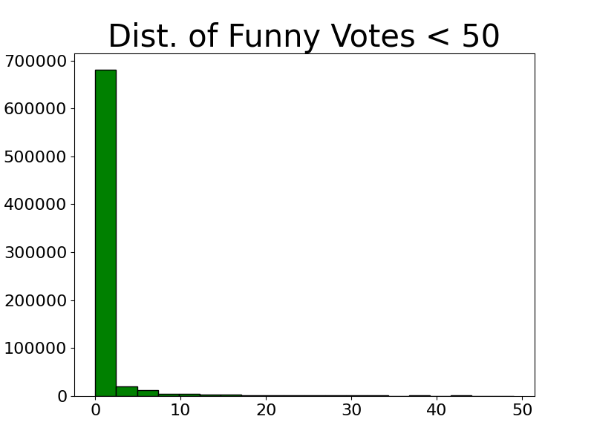
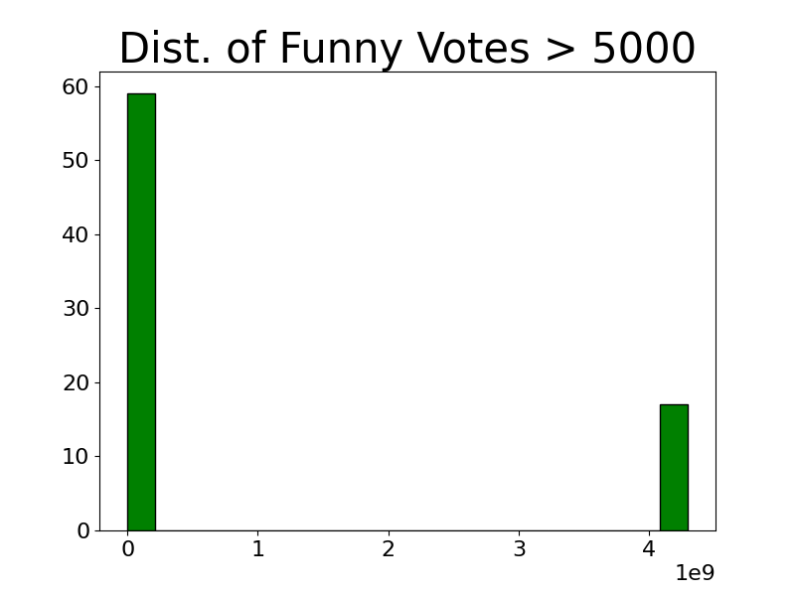
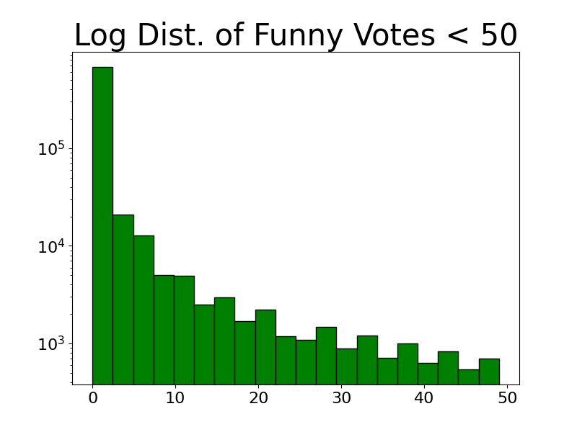
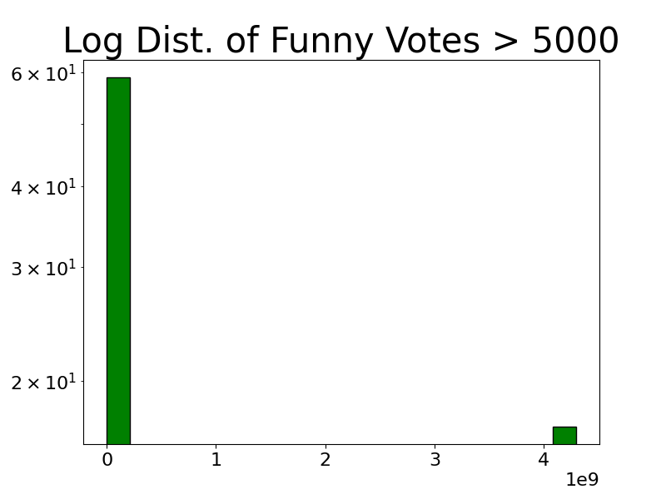
There is a sparsity in reviews with funny votes > 5000.

Slide 8
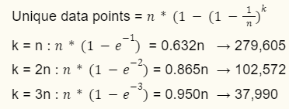
Bootstrapping
With 1,000,000 data points, my first step is to remove some data
Sample with replacement. These indices are dropped
Set difference → Return not sampled indices
80% train; 20% validation split
Sampling k points on the range (0, N) I will expect
For K Nearest Neighbors classification, I use a bootstrap factor of 3.
For Random Forest classification, I use a bootstrap factor of 5.

Slide 9
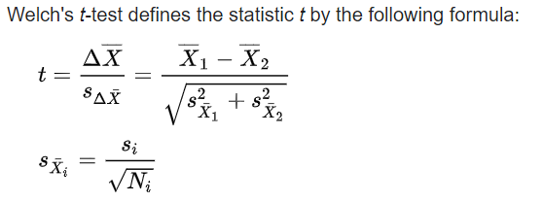
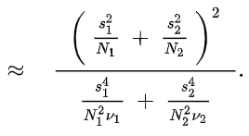
Welch’s T Test
Welch’s t-test is a variant to Student’s t-test that overcomes the assumption of equal variance. Welch’s t-test still assumes normality between samples.
H₀: μ₁= μ₂
H_{a}: μ₁≠ μ₂
d.f.
Wikipedia: welch’s t-test

Slide 10
K Nearest Neighbors
Predicting Hours Played

Slide 11
K Nearest Neighbor Feature Subsets
Five hopeful groups
All
'helpful','funny','polarity','objectivity','n_words','n_sentences'
Vote count
'helpful','funny'
TextBlob
‘polarity’,'objectivity'
TextBlob extra
‘n_words’,‘n_sentences’,‘polarity’, 'objectivity'
Pass chi-squared p = 0.05
'helpful','funny',objectivity,’n_words’,’n_sentences’
Dropped polarity
Notes:
Polarity, objectivity
Just one hot them
All other values are just fine as is.
Euclidean_dist –
½ (||x - y||)^2 – onehot
Onehot or continuous mask
Euc dist norm. Can take the norm difference of a single element. Forbenius norm (1 norm). row sum | x-y |
Mean =
Std_error =
normalize inside euc dist method.

Slide 12
K Nearest Neighbors Trials
Trial 1– 120 runs
5 feature subsets
4 Target Discretization Strategies
Range
Frequency
K-Means
Equal Range on log(hours_played)
4 bin sizes to discretize targets into
3, 8, 12, 20
2 choices for k
5, 87
Trial 2– 300 runs
5 feature subsets
1 Target Discretization Strategie
Frequency
20 bin sizes to discretize targets into
[ 5 10 15 20 25 30 35 40 45 50 55 60 65 70 75 80 85 90 95 100]
3 choices for k
5, 100, 1000

Slide 13
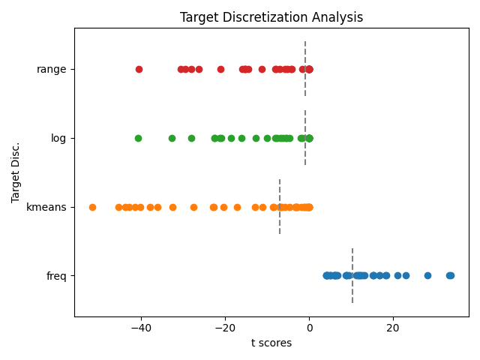
Target Discretization Analysis
Equal frequencies was the best target discretization strategy.

Slide 14
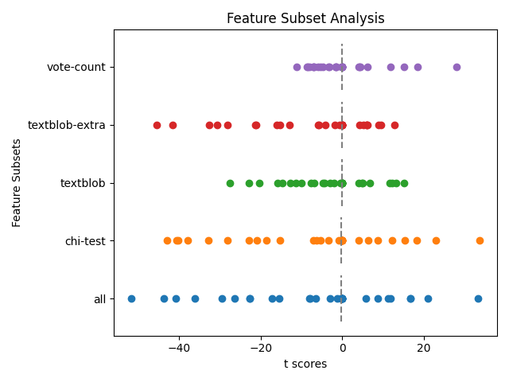
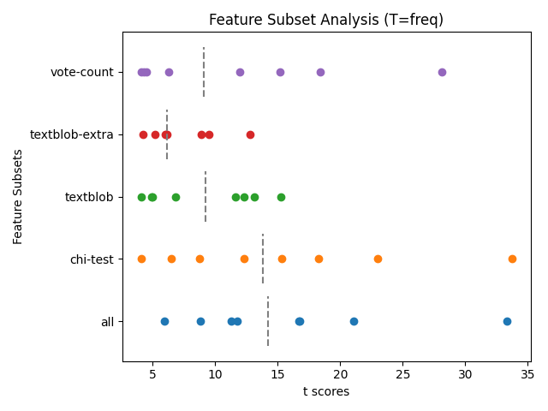

Slide 15
F=all_T=freq_GROUP=3_K=5
F=all_T=freq_GROUP=8_K=5
F=all_T=freq_GROUP=12_K=5
F=all_T=freq_GROUP=20_K=5
F=chi_test_T=freq_GROUP=3_K=5
F=chi_test_T=freq_GROUP=8_K=5
F=chi_test_T=freq_GROUP=12_K=5
F=chi_test_T=freq_GROUP=20_K=5
F=textblob_extra_T=freq_GROUP=3_K=5
F=textblob_extra_T=freq_GROUP=8_K=5
F=textblob_extra_T=freq_GROUP=12_K=5
F=textblob_extra_T=freq_GROUP=20_K=5
F=textblob_T=freq_GROUP=3_K=5
F=textblob_T=freq_GROUP=8_K=5
F=textblob_T=freq_GROUP=12_K=5
F=textblob_T=freq_GROUP=20_K=5
F=vote_count_T=freq_GROUP=3_K=5
F=vote_count_T=freq_GROUP=8_K=5
F=vote_count_T=freq_GROUP=12_K=5
F=vote_count_T=freq_GROUP=20_K=5
F=all_T=freq_GROUP=3_K=87
F=all_T=freq_GROUP=8_K=87
F=all_T=freq_GROUP=12_K=87
F=all_T=freq_GROUP=20_K=87
F=chi_test_T=freq_GROUP=3_K=87
F=chi_test_T=freq_GROUP=8_K=87
F=chi_test_T=freq_GROUP=12_K=87
F=chi_test_T=freq_GROUP=20_K=87
F=textblob_extra_T=freq_GROUP=3_K=87
F=textblob_extra_T=freq_GROUP=8_K=87
F=textblob_extra_T=freq_GROUP=12_K=87
F=textblob_extra_T=freq_GROUP=20_K=87
F=textblob_T=freq_GROUP=3_K=87
F=textblob_T=freq_GROUP=8_K=87
F=textblob_T=freq_GROUP=12_K=87
F=textblob_T=freq_GROUP=20_K=87
F=vote_count_T=freq_GROUP=3_K=87
F=vote_count_T=freq_GROUP=8_K=87
F=vote_count_T=freq_GROUP=12_K=87
F=vote_count_T=freq_GROUP=20_K=87
Trial 1 classifiers which improve over Majority Class Baseline
Statistically significant at p = 1e-5
Others were statistically Insignificant at p = 0.05
Best classifier accuracy improvement over majority class is 5.8%
Most knn classifiers using k-means or equal range discretization performed significantly worse than the Majority Classifier
Notes:
Prolly won’t use. Same analysis as my graph, but less clear

Slide 16
Pairwise T-Tests on Feature Subset
Key Takeaways
Textblob-extra and textblob perform poorly as feature subsets.
Welch’s unequal variance t-test
Cutoff p-value of 0.05
Summed across all 120 trials:
k = [5, 87]
Target Discretize = range, frequency, k means
Group size = [3, 8, 12, 20]
Feature Subset Rankings
Losers
Vote Count
All
Chi-Test
Textblob
Textblob Extra
 | vote-count | all | textblob | chi-test | textblob-extra
vote-count | 0 | 4 | 7 | 5 | 7
all | 1 | 0 | 6 | 1 | 7
textblob | 0 | 4 | 0 | 3 | 6
chi-test | 0 | 0 | 5 | 0 | 8
textblob-extra | 1 | 0 | 1 | 0 | 0
Winners
Notes:
Scatterplot the t scores. 5 lines for each of the feature subsets. Vertical bins. Continuous on x-axis: t-score.

Slide 17
Helpful and Funny Votes are the most important features when determining Hours Played, using a K Nearest Neighbors Classifier
Hours played is public on the review. Higher hours played could give credibility to the review, increasing the community’s votes.
The Steam algorithm which orders the reviews on its page could preference reviews which higher hours played.
An individual who played the game for longer might put more effort into making a well-written review.

Slide 18
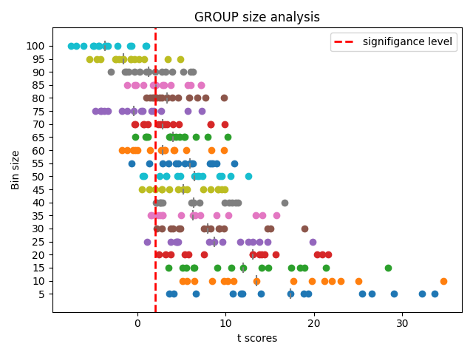

Slide 19
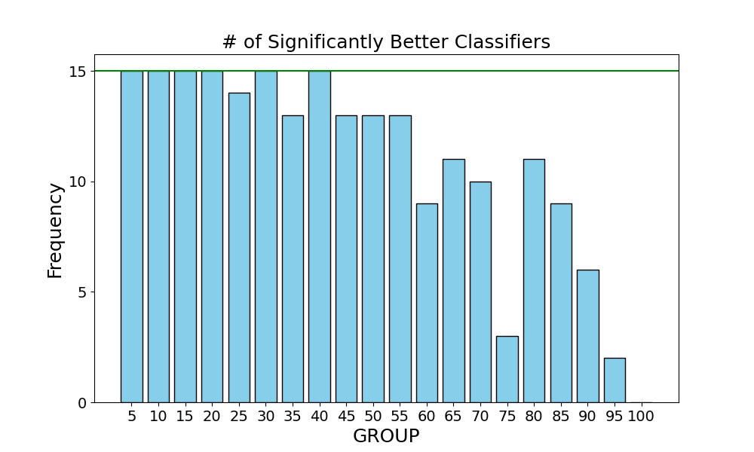
Trial 2
T > T_{critical} ≈ 2.04

Slide 20
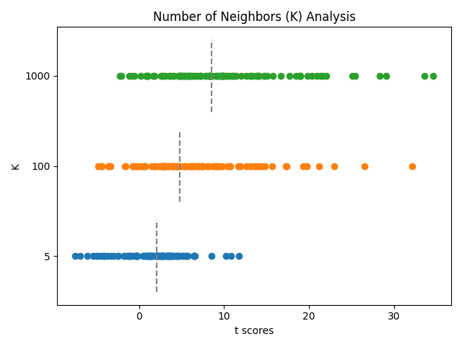

Slide 21
Trial 2– K and Target Discretization Analysis
2nd Hyperparameter search for KNN. Focusing on the best group size
GROUP = [5 10 15 20 25 30 35 40 45 50 55 60 65 70 75 80 85 90 95 100]
5 feature subsets
2 target Discretize strategies
3 choices for K
Log_Range Disc – discretize on equal ranges after taking the logarithm of hours_played.
Target Disc | K | # of Classifies which are significantly better than the Majority Classifier (max=100)
Log_Range | 5 | 0
Log_Range | 10 | 0
Log_Range | 1000 | 0
Freq | 5 | 53
Freq | 100 | 76
Freq | 1000 | 88

Slide 22
Evaluation on the Test Set
Model:
Feature: vote count
Target disc: equal frequency
Group: 8
K = 5 and 1000
K = 5
Class Acc = 0.1322
Majority Acc = 0.1250
0.72% improvement over majority classifier
K = 1000
Class Acc = 0.1394
Majority Acc = 0.1256
1.38% improvement over majority classifier

Slide 23
Random Forests
Predicting Hours Played

Slide 24
Random Forest Parameters
Each trial is ran 30 times to provide enough samples for t-testing
Bootstrap factor is now 5.
Ensemble 100 trees
Max Features = # features
Criterion
Entropy
Gini
Log
Random
Target Disc
Uniform
K means
Frequency
Equal range on log(hours_played)
Four Legacy Groups
Continuous All– 'helpful','funny','polarity','objectivity','n_words','n_sentences'
Vote count– 'helpful','funny'
TextBlob– ‘polarity’,'objectivity'
TextBlob extra– ‘n_words’,‘n_sentences’,‘polarity’, 'objectivity'
Nine hopeful groups
game_name, overall_player_rating
publisher, overall_player_rating
developer, overall_player_rating
game_name, publisher, developer, overall_player_rating
recommendation, game_name, overall_player_rating
recommendation, publisher, overall_player_rating
recommendation, developer, overall_player_rating
recommendation, game_name, publisher, developer, overall_player_rating
All categorical AND continuous features.
Notes:
Polarity, objectivity
Just one hot them
All other values are just fine as is.
Euclidean_dist –
½ (||x - y||)^2 – onehot
Onehot or continuous mask
Euc dist norm. Can take the norm difference of a single element. Forbenius norm (1 norm). row sum | x-y |
Mean =
Std_error =
normalize inside euc dist method.

Slide 25
Random Forest Analysis– Target Disc. and Split Criterion
Target Disc | # pass t-tests Max = 52
Uniform
K means
Frequency | 49
Equal Range on log(hours_played) | 0
Split Criterion | # pass t-tests Max = 52
Entropy | 11
Gini | 12
Log | 13
Random | 13
Frequency is the only statistically justified choice for target discretization.
Almost no variation in the number of passed t-tests are accounted for by the criterion choice.

Slide 26
Random Forest Analysis– Pairwise T-Test on Feature Subsets
Max = 16
 | 1. | 2. | 3. | 4. | 5. | 6. | 7. | 8. | 9. | All Continuous | Textblob | Textblob Extra | Vote Count
1. | 0 | 4 | 2 | 0 | 2 | 0 | 2 | 1 | 8 | 8 | 8 | 8 | 8
2. | 0 | 0 | 1 | 0 | 1 | 0 | 1 | 2 | 8 | 8 | 8 | 8 | 7
3. | 0 | 2 | 0 | 0 | 1 | 0 | 1 | 1 | 8 | 8 | 8 | 8 | 7
4. | 0 | 4 | 0 | 0 | 0 | 0 | 0 | 1 | 8 | 8 | 8 | 8 | 7
5. | 3 | 4 | 5 | 2 | 0 | 2 | 2 | 2 | 8 | 8 | 8 | 8 | 8
6. | 0 | 4 | 0 | 0 | 1 | 0 | 1 | 1 | 8 | 8 | 8 | 8 | 7
7. | 0 | 4 | 1 | 0 | 0 | 0 | 0 | 0 | 8 | 8 | 8 | 8 | 8
8. | 1 | 4 | 4 | 2 | 0 | 3 | 0 | 0 | 8 | 8 | 8 | 8 | 7
9. | 0 | 0 | 0 | 0 | 0 | 0 | 0 | 0 | 0 | 7 | 5 | 7 | 4
All Continuous | 0 | 0 | 0 | 0 | 0 | 0 | 0 | 0 | 1 | 0 | 3 | 2 | 0
Textblob | 0 | 0 | 0 | 0 | 0 | 0 | 0 | 0 | 0 | 3 | 0 | 4 | 0
Textblob Extra | 0 | 0 | 0 | 0 | 0 | 0 | 0 | 0 | 1 | 2 | 1 | 0 | 0
Vote Count | 0 | 0 | 0 | 0 | 0 | 0 | 0 | 0 | 4 | 8 | 8 | 8 | 0
Notes:
Is it deceptive to include target_disc = log(hours_played)?
Those tests aren’t signif diff from majority classifier. So can I say anything about them as a comparison?
Key Takeaway
Continuous variables are worse than categorical

Slide 27
Evaluation on the Test Set
Model:
Feature = group 8
Recommendation, game_name, publisher, developer, overall_player_rating
Target disc = equal frequency
Group = 8
Criterion = Random
K = 5
Class Acc = 0.1322
Majority Acc = 0.1250
0.72% improvement over majority classifier
K = 1000
Class Acc = 0.1394
Majority Acc = 0.1256
1.38% improvement over majority classifier

Slide 28
Random Forest
Predicting Recommendation

Slide 29
Predict Recommendation using Random Forests
TextBlob Groups
TextBlob 1 – 'n_words'
TextBlob 2 – 'n_sentences'
TextBlob 3 – 'polarity'
TextBlob 4 – 'subjectivity'
TextBlob_length – 'n_words', 'n_sentences'
TextBlob_sentiment – 'polarity', 'subjectivity'
TextBlob_pair1 – 'n_words', 'polarity'
TextBlob_pair2 – 'n_words', 'subjectivity'
TextBlob_pair3 – 'n_sentences', 'polarity'
TextBlob_pair4 – 'n_sentences', 'subjectivity'
TextBlob_all – 'polarity', 'subjectivity', 'n_words', 'n_sentences'
Bootstrap factor of 5.
Each trial is ran 30 times to provide enough samples for t-testing
Ensemble 100 trees
Max Features = # features
Criterion
Entropy
Gini
Log
Random
Notes:
Polarity, objectivity
Just one hot them
All other values are just fine as is.
Euclidean_dist –
½ (||x - y||)^2 – onehot
Onehot or continuous mask
Euc dist norm. Can take the norm difference of a single element. Forbenius norm (1 norm). row sum | x-y |
Mean =
Std_error =
normalize inside euc dist method.

Slide 30
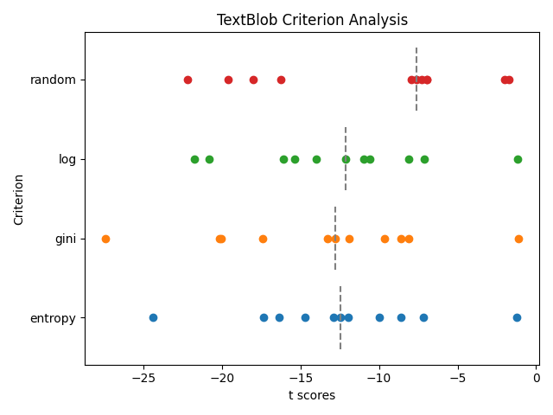
Across 11 feature subsets, splitting the tree using a random attribute maximizes validation performance. The other split criterion are deterministic, that is, each ensembled tree would have the same split decisions using the same bootstrapped data. Random criterion introduces stochasticity, allowing the ensembling to actually do something.

Slide 31
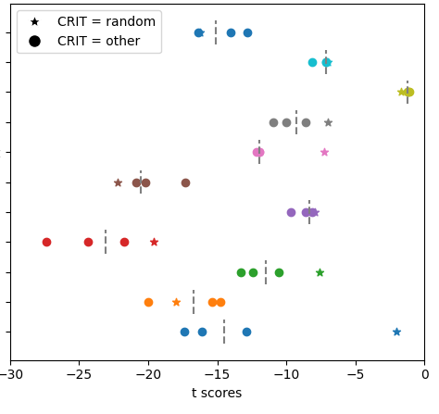
Feature Subset Analysis
subjectivity
polarity
# sentences
# words
polarity, subjectivity
# sentences, subjectivity
# sentences, polarity
# words, subjectivity
# words, polarity
# words, # sentences
All 4 features

Slide 32
Predict Recommendation using Random Forests
Nine hopeful groups
game_name, overall_player_rating
publisher, overall_player_rating
developer, overall_player_rating
game_name, publisher, developer, overall_player_rating
hours_played, game_name, overall_player_rating
hours_played, publisher, overall_player_rating
hours_played, developer, overall_player_rating
hours_played, game_name, publisher, developer, overall_player_rating
hours_played, game_name, publisher, developer, overall_player_rating, Helpful, funny, n_words, n_sentences, polarity, subjectivity
Bootstrap factor of 5.
Each trial is ran 30 times to provide enough samples for t-testing
Ensemble 100 trees
Max Features = # features
Criterion
Entropy
Gini
Log
Random
Notes:
Polarity, objectivity
Just one hot them
All other values are just fine as is.
Euclidean_dist –
½ (||x - y||)^2 – onehot
Onehot or continuous mask
Euc dist norm. Can take the norm difference of a single element. Forbenius norm (1 norm). row sum | x-y |
Mean =
Std_error =
normalize inside euc dist method.

Slide 33
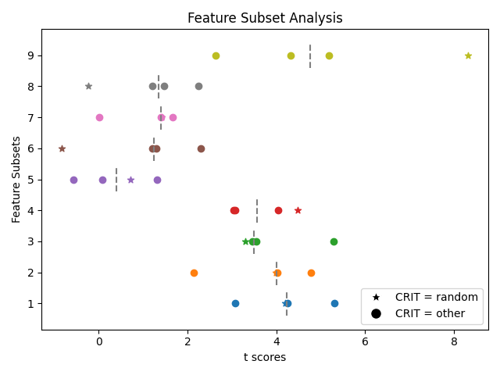
analysis

Slide 34
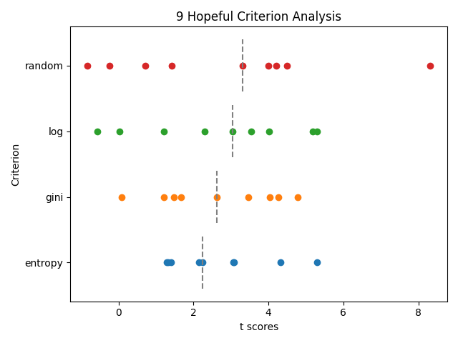
analysis

Slide 35
Incorporating Helpful and Funny Votes for Final Feature Subset Test
Final Set
Helpful
Funny
Helpful, Funny
Helpful, funny, n_sentences – best performing among
Helpful, funny, n_words, n_sentences, polarity, subjectivity TextBlob Feature Subsets

Slide 36
Evaluation on the Test Set
Model:
Features
Recommendation, game_name, publisher, developer, overall_player_rating
Criterion = Random

Slide 37
Conclusions

